Slide 1
Introduction to DAX Measures
Teruyuki Ito
Reporting & Data Visualisation Manager

Slide 2
What is Measures?
Measures are calculations used in Power BI to analyse and manipulate data dynamically.
They help in creating KPIs, dynamic calculations, and custom aggregations based on DAX (Data Analysis Expressions).
Enhances data insights
Enables customized calculations
Supports dynamic visuals

Slide 3
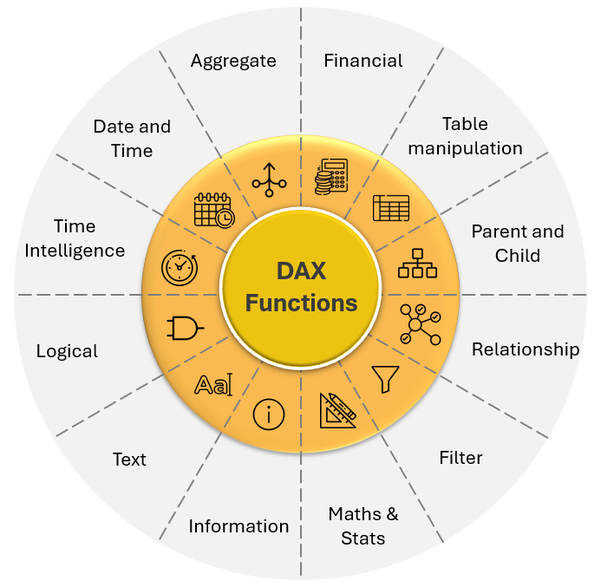
What is DAX (Data Analysis Expressions)?
DAX is a formula language designed specifically for data modeling and analysis in Power BI, Power Pivot, and Analysis Services.
Used for creating measures, calculated columns, and tables.
Basic Functions:
Aggregation: SUM, COUNT, AVERAGE
Logical: IF, AND, OR
Time Intelligence: YEAR, MONTH, DATEADD
Statistical: MEDIAN, MIN, MAX

Slide 4

Types of Measures
Explicit Measures:
Created by users, reusable across reports and visualizations.
Implicit Measures:
Automatically created by Power BI (e.g., default aggregations) when a field is used in visuals.

Slide 5
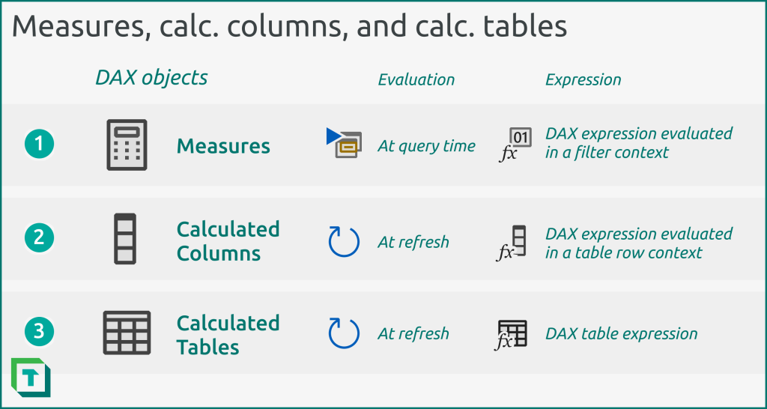
The main difference…

Slide 6

Best Practices
Use CALCULATE Wisely: Use it only when necessary as it can slow down calculations.
MINIMIZE COMPLEXITY: Try not to nest functions heavily, which can lead to slower performance. Example: Simplify your formula if possible, and avoid iterative functions like SUMX if a direct SUM would suffice.
Naming Conventions: Use descriptive names for ease of understanding.
Document Calculations: Use comments in DAX if complex.
Create a Dedicated table for DAX measures

Slide 7
The structure;
Total Profit = sum(Products[Profit])
The name of the measure or calculated column
DAX function
The table
The specific column

Slide 8
The Big Question!
To DAX or not to DAX?

Slide 9
Exercise;
Please create the following Measures in the Power BI data model from Product table;
Total Profit
Avg Profit
Highest Profit
Total Sales
Profit Ratio
First Order Date
Last Order Date

